Slide 1
CSD1401 Software Engineering Project 1
Movement
Game Loop Revision
Euler Integration

Slide 2
Game Loop Revision

Slide 3
Game Loop Revision
Purpose of each Loop?

Slide 4
Game Loop Revision
Purpose of each Loop?
Generate 1 Frame

Slide 5
Game Loop Revision
Many systems contribute to changes between frames
User input
Physics (forces, velocity)
Artificial Intelligence (decision making)
Intersection Responses
Animations
Other forms of logic (example : Game Of Life)

Slide 6
Game Loop Revision
Note the most important factor between frames
TIME
Frames Per Second, FPS
A game loop prepares one frame, so each loop has 1/FPS of a second to prepare the frame
For 60 fps, each frame is 0.016s
Each of the systems may share or use different interpretations of the time between frames

Slide 7
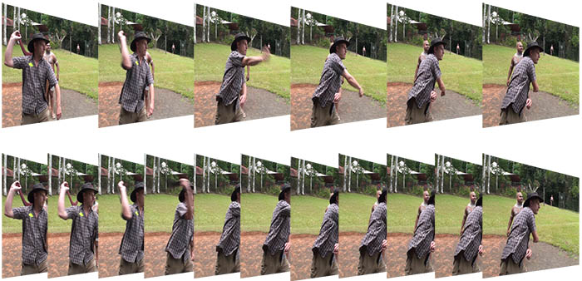
Game Loop Revision
In this example, note that result is based on time, independent of framerate

Slide 8
Game Loop Revision
CProcessing handles the framerate for you
/* set framerate to 2 fps (slow)*/
CP_System_SetFrameRate(2.0f);
/*Current frame count,
starts at 0
and increments every frame until program ends*/
int currentFrameCount = CP_System_GetFrameCount();
/* get dt, time elapsed from last frame*/
float currentElapsedTime = CP_System_GetDt();
/*updating total elapsed time*/
static float totalElapsedTime = 0;
totalElapsedTime += currentElapsedTime;

Slide 9
Euler Integration

Slide 10
Integration
Update our moving bodies over time, across multiple frames
Euler’s Integration
Acceleration = Force / Mass
Velocity += Acceleration * deltaTime
Position += Velocity * deltaTime

Slide 11
Integration
Euler’s Integration
Acceleration = Force / Mass
Velocity += Acceleration * deltaTime
Position += Velocity * deltaTime
Note that this happens across frames, so you will need to have variables to accumulate over time

